Slide 1
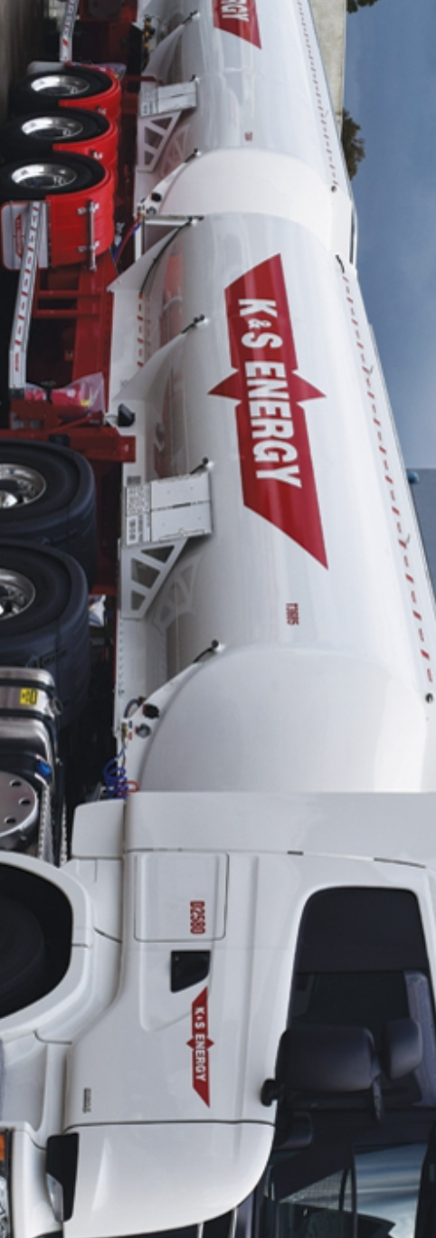
K&S Corporation
Group 5
K&S Corportation
Members: Siheng Liu Pengrui Ma
Yimin Xu
Yiyan Yang

Slide 2
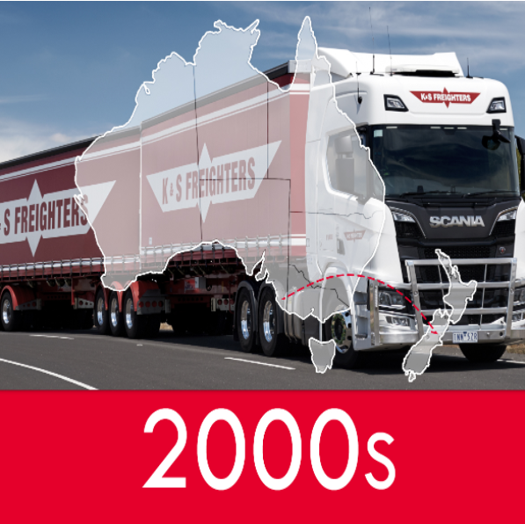

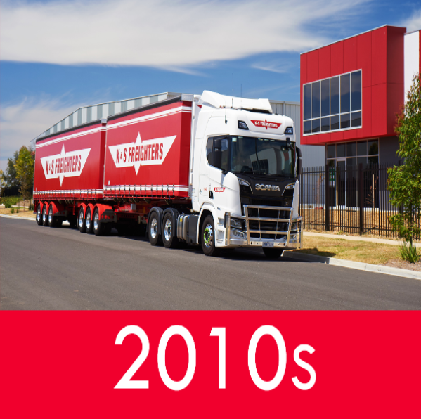

Background
Brief History
Formed in 1945 and kept evolving to one of Australia and New Zealand’s largest National multi-modal providers of transport and distribution services.
Key Business Objectives
road, rail and coastal sea forwarding...
multiple sub-companies
Challenges
COVID-19
Increasing needs in logistics
Higher standard

Slide 3
Business Model Canvas
Key Partners
Key Activities
Value Proposition
Relation
-ships
Customers
Bulk load
Energy/material
Warehousing
Supply chain
Import/Export
1. General Values
good brand reputation
convenience and reliability
2. Special Values
risk reduction during the Covid-19
environmental-friendly
1. Logistics Part
com. related to
freighter
energy
chemtrans
2. Fuels Part
airline
fules
3. Rent Part
com. related to
buildings
mining and resources
Government
Fuel providers
Retailers and bulk Suppliers.
Insurance company
Medical supplies
Auto service provider
Supplier and demander
Custemer service
Channel
Key Resources
Physical store
Brand linkage
Customization promotion
Website
Truck/rail/ship Fleet 4552+ vehicles
Warehouse
2700+ employees
Cost Structure
Revenue Streams
Staff $217.8M
Depreciation $52.5M
Finance costs $3.4M
Miscellaneous $7.3M
Logistics of services: $583M
Sale of goods: $105M
Agency commission from fuel sales: $120M

Slide 4
Business Model Canvas
Value Proposition
1. General Values
good brand reputation
convenience and reliability
2. Special Values
risk reduction during the Covid-19
environmental-friendly

Slide 5
Business Model Canvas
Value Proposition
Customers
1. General Values
good brand reputation
convenience and reliability
2. Special Values
risk reduction during the Covid-19
environmental-friendly
1. Logistics Part
com. related to
freighter
energy
chemtrans
2. Fuels Part
airline
fules
3. Rent Part
com. related to
buildings
mining and resources

Slide 6
Business Model Canvas
Value Proposition
Customers
1. General Values
good brand reputation
convenience and reliability
2. Special Values
risk reduction during the Covid-19
environmental-friendly
1. Logistics Part
com. related to
freighter
energy
chemtrans
2. Fuels Part
airline
fules
3. Rent Part
com. related to
buildings
mining and resources
Revenue Streams
Logistics of services: $583M
Sale of goods: $105M
Agency commission from fuel sales: $120M

Slide 7
Business Model Canvas
Value Proposition
Customers
1. General Values
good brand reputation
convenience and reliability
2. Special Values
risk reduction during the Covid-19
environmental-friendly
1. Logistics Part
com. related to
freighter
energy
chemtrans
2. Fuels Part
airline
fules
3. Rent Part
com. related to
buildings
mining and resources
Channel
Physical store
Brand linkage
Customization promotion
Website
Revenue Streams
Logistics of services: $583M
Sale of goods: $105M
Agency commission from fuel sales: $120M

Slide 8
Business Model Canvas
Value Proposition
Relation
-ships
Customers
1. General Values
good brand reputation
convenience and reliability
2. Special Values
risk reduction during the Covid-19
environmental-friendly
1. Logistics Part
com. related to
freighter
energy
chemtrans
2. Fuels Part
airline
fules
3. Rent Part
com. related to
buildings
mining and resources
Supplier and demander
Custemer service
Channel
Physical store
Brand linkage
Customization promotion
Website
Revenue Streams
Logistics of services: $583M
Sale of goods: $105M
Agency commission from fuel sales: $120M

Slide 9
Business Model Canvas
Key Activities
Value Proposition
Relation
-ships
Customers
Bulk load
Energy/material
Warehousing
Supply chain
Import/Export
1. General Values
good brand reputation
convenience and reliability
2. Special Values
risk reduction during the Covid-19
environmental-friendly
1. Logistics Part
com. related to
freighter
energy
chemtrans
2. Fuels Part
airline
fules
3. Rent Part
com. related to
buildings
mining and resources
Supplier and demander
Custemer service
Channel
Physical store
Brand linkage
Customization promotion
Website
Revenue Streams
Logistics of services: $583M
Sale of goods: $105M
Agency commission from fuel sales: $120M

Slide 10
Business Model Canvas
Key Activities
Value Proposition
Relation
-ships
Customers
Bulk load
Energy/material
Warehousing
Supply chain
Import/Export
1. General Values
good brand reputation
convenience and reliability
2. Special Values
risk reduction during the Covid-19
environmental-friendly
1. Logistics Part
com. related to
freighter
energy
chemtrans
2. Fuels Part
airline
fules
3. Rent Part
com. related to
buildings
mining and resources
Supplier and demander
Custemer service
Channel
Key Resources
Physical store
Brand linkage
Customization promotion
Website
Truck/rail/ship Fleet 4552+ vehicles
Warehouse
2700+ employees
Revenue Streams
Logistics of services: $583M
Sale of goods: $105M
Agency commission from fuel sales: $120M

Slide 11
Business Model Canvas
Key Partners
Key Activities
Value Proposition
Relation
-ships
Customers
Bulk load
Energy/material
Warehousing
Supply chain
Import/Export
1. General Values
good brand reputation
convenience and reliability
2. Special Values
risk reduction during the Covid-19
environmental-friendly
1. Logistics Part
com. related to
freighter
energy
chemtrans
2. Fuels Part
airline
fules
3. Rent Part
com. related to
buildings
mining and resources
Government
Fuel providers
Retailers and bulk Suppliers.
Insurance company
Medical supplies
Auto service provider
Supplier and demander
Custemer service
Channel
Key Resources
Physical store
Brand linkage
Customization promotion
Website
Truck/rail/ship Fleet 4552+ vehicles
Warehouse
2700+ employees
Revenue Streams
Logistics of services: $583M
Sale of goods: $105M
Agency commission from fuel sales: $120M

Slide 12
Business Model Canvas
Key Partners
Key Activities
Value Proposition
Relation
-ships
Customers
Bulk load
Energy/material
Warehousing
Supply chain
Import/Export
1. General Values
good brand reputation
convenience and reliability
2. Special Values
risk reduction during the Covid-19
environmental-friendly
1. Logistics Part
com. related to
freighter
energy
chemtrans
2. Fuels Part
airline
fules
3. Rent Part
com. related to
buildings
mining and resources
Government
Fuel providers
Retailers and bulk Suppliers.
Insurance company
Medical supplies
Auto service provider
Supplier and demander
Custemer service
Channel
Key Resources
Physical store
Brand linkage
Customization promotion
Website
Truck/rail/ship Fleet 4552+ vehicles
Warehouse
2700+ employees
Cost Structure
Revenue Streams
Staff $217.8M
Depreciation $52.5M
Finance costs $3.4M
Miscellaneous $7.3M
Logistics of services: $583M
Sale of goods: $105M
Agency commission from fuel sales: $120M

Slide 13
Aspirations
To be leading provider of transport and logistics solutions within our target markets in Australia and New Zealand
Safety
Customer Service
People & Community
Innovation
Objective
Strategies
1. Create a pandemic protocol
2. Provide paid time off for vaccinated employees
3. Conduct a comprehensive investigation of security incidents
Everybody Safe Every day
1. Develop and deploy logistics system to provide customers
with efficiency benefits
2. Adjust the business structure to meet customer needs
Continue to meet and exceed
customer needs
Respect and care for our
employees and communities
1. Create a positive work environment
2. Upgrade fleet to improve environmental performance
Create value for shareholders
and opportunities for people
1. Improve operating efficiency and reduce operating costs
2. Provide employees with a variety of functional and
vocational training

Slide 14
Be the tier one Australasia logistics corporation in the development and provision of specialist logistics solutions.
Vision
√
Operating revenues return to pre-pandemic levels in 2022, increasing by 14.8%
Economic
√
Keep on promoting Logistics 4.0 in the following 5 years
添加标题
Goals
√
Environmental
Technical
Develop Green-logistics in the following 5 years, reduce emission load by 5% per year
Economical

Slide 15
Mapping Requirements to Goals
Goals
Requirements
G1 | Operating revenues return to pre-pandemic levels in 2022, increasing by 14.8% | R1.1 Department consolidation R1.2 Enact pandemic countermeasure R1.3 Extend business scope R1.4 Secure parcels of rail volumes
G2 | Keep on promoting Logistics 4.0 in the following 5 years | R2.1 Standardization and modularization of logistics industry R2.2 Individuation and intellectualization of software and control system R2.3 Digitization and automation based on intelligent sensors and products R2.4 Digital Twin to help product lifecycle management (PLM) R2.5 Logistics optimization and decision support based on artificial intelligence R2.6 Human-machine Cooperation
G3 | Developing Green-logistics in the following 5 years, reduce emission load by 5% per year | R3.1 Include eco-friendly criteria in your procurement policies R3.2 Optimize transport fleet management R3.3 Warehouse that follows sustainable construction and management standards R3.4 Enable measures to reduce and recycle the waste produced R3.5 Improve stock management and reverse logistics processes
Kain&Shelton

Slide 16
√
Operating revenues return to pre-pandemic levels in 2022, increasing by 14.8%
Economic
√
Keep on promoting Logistics 4.0 in the following 5 years
添加标题
Goals
Environmental
Technical
Economical
√
Develop Green-logistics in the following 5 years, reduce emission load by 5% per year

Slide 17
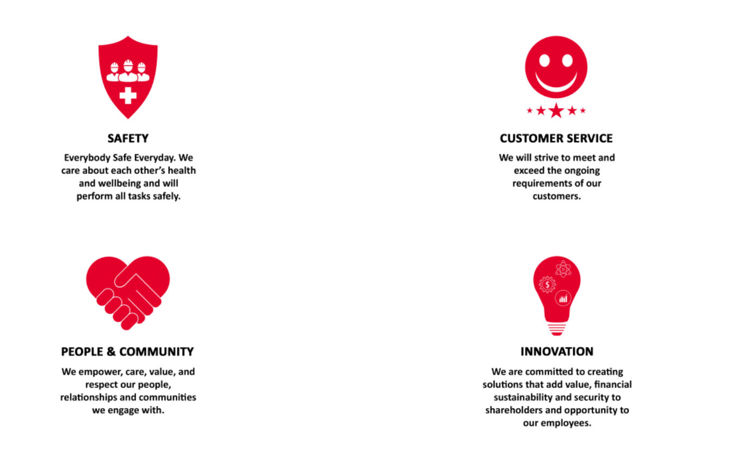
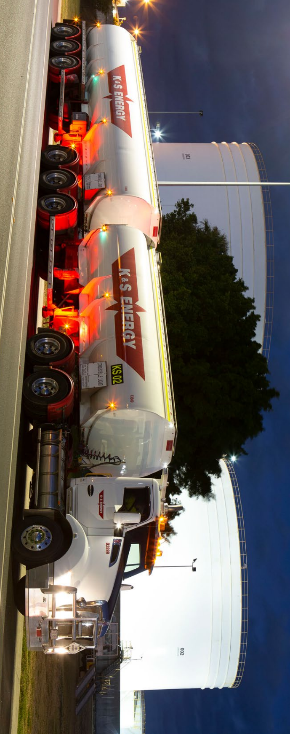
Thank You
Q & A
K&S Corportation

Slide 18
References
[1] K&amp;S Corporation. (n.d.). Retrieved March 10, 2022, from https://www.ksgroup.com.au/
[2] McCabe, JD 2007, ‘Network analysis, architecture, and design’ 3rd ed., Morgan Kaufmann, San Francisco, CA.
[3] Oppenheimer, P 2011, ‘Top-down network design’ Third edition., Cisco Press, Indianapolis, IN, USA.
[4] Practical Action. 2022. Business Model Canvas - Practical Action. [online] Available at: <https://practicalaction.org/pmsd-toolkit/tools/business-model canvas/?gclid=CjwKCAiAvaGRBhBlEiwAiYyMNODxeg_MLJM3X8e_nHue4yPDe5V6g0jAQLJQBhZm0ecsdEk-FaJ7BoCoJ8QAvD_BwE> [Accessed 9 March 2022].
[5] Waste management paper 4. http://ksgroup.in/. (n.d.). Retrieved March 10, 2022, from http://ksgroup.in/waste-management-paper-4

